Slide 1
Python Programming

Slide 2
Introduction
Program:
Sequence of steps given as instructions to perform a specific computation.
Debugging:
Tracking the errors in the program written and resolving them is debugging.
Interpreter language:
The program is interpreted directly without compiling the program.
Example: Python & PHP

Slide 3
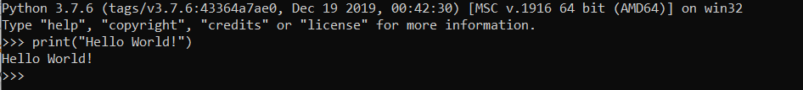
First Python Program
Installation process:
In your web browser and navigate to the Downloads for Windows section of the official Python website.
Download either the Windows x86-64 executable installer or
Windows x86 executable installer
Run the Executable Installer
Test it:

Slide 4
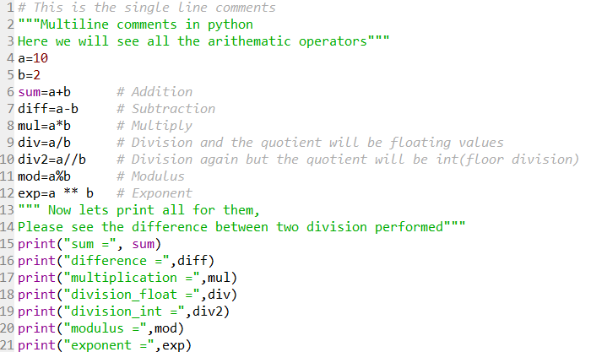
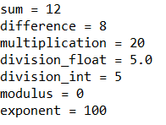
Important intro notes
Comments
Single-Line
Multi-Line
Variable declaration
Arithmetic Operators

Slide 5
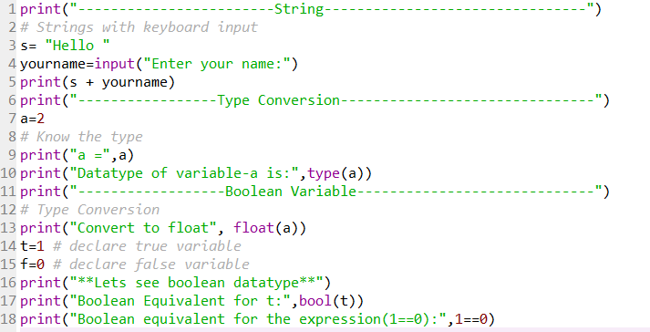
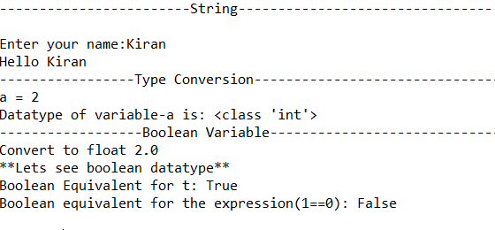
Important intro points
Strings
Input from Keyboard
Type Conversion
Boolean Variables

Slide 6
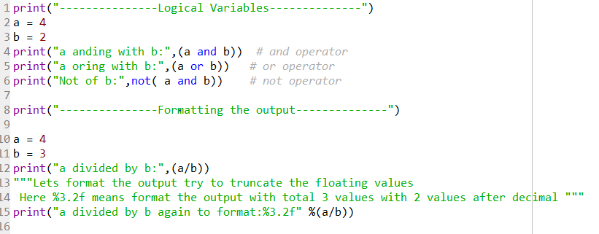
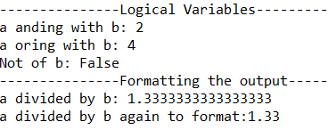
Important intro points
Logical Variables
Formatting Output

Slide 7
End of Introduction-Theory

Slide 8
Exercise Questions
Area and Circumference of a Circle
Print Ascii Value of the Character and vice-versa
Area of Triangle, Square, Rectangle
Simple Interest
Gross Salary of an Employee
Percentage of 5 Subjects
The Display Size of the Different Data Type
Write programs to evaluate each of the following equations.
(i) V = u + at. (ii) S = ut+1/2a
(iii) T=2*a+√b+9c (iv) H = √b² +p²
Converting Temperature Celsius into Fahrenheit and vice-versa
Read Integer (N) and Print the First Three Powers (N^1, N^2, N^3)
Source: https://www.programmingwithbasics.com/p/list-c-language-programs.html

Slide 9

For Solutions

